Slide 1

Immune Receptor Profiling Nanocourse: Session 2- Community standards, Data analysis and interpretation
Organized by the VDJServer Team
June 1, 2018
UT Southwestern Medical Center

Slide 2
AGENDA
8:45am – 9:00am Setup, Registration, provide workshop handouts to participants
9:10am – 10:30am Introduction session
9:10am – 10:30am: Immune system overview (including immune sequencing technology and summary of vdjserver workflow for analysis); Setup IgBlast jobs with demo files
Show slides and video
10:30am-10:40am Break
10:40am – 11:45am Session 1- Data digest
Demo data and VDJServer hands-on demonstrations
Elaborate on the functionalities and benefits of VDJServer such as: no need to install anything, reproducibility, easy to use, data is stored on your account and is private, collaborative sharing of data, and long term archiving.
Breakout and setup RepCalc VDJServer “jobs” (provide one-on-one assistance and point participants to quickstart protocol @ handout pages)
11:45am – 1:00pm Lunch
1:00pm – 2:40pm Session 2- Community standards, Data analysis and interpretation
Look at example of pre-processing using FASTQ files
MiAIRR Standards overview and discussion
Analysis and interpretation of repertoire calculations output
2:40pm-2:55pm Break
3:00pm-3:45pm
Downstream application of VDJServer products in machine learning (example dataset using the demo dataset and discussion of some outcomes)
3:45pm-4:15pm
Summarize the workshop and encourage future interactions
Invitation to use some example datasets for further analysis (VDJServer team will assist in setup as time permits)

Slide 3
Session 2 objectives
Demonstration of pre-processing tasks using fastq files (using example data from a vdjserver project)
Review the MiAIRR Standards (discuss the steps involved and how to approach these steps for submission of data during publication)
Analyze and interpret data from repertoire calculations

Slide 4
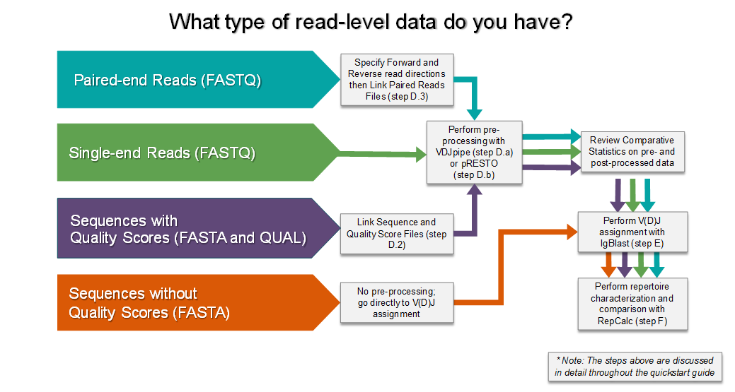
Pre-processing with Fastq files

Slide 5
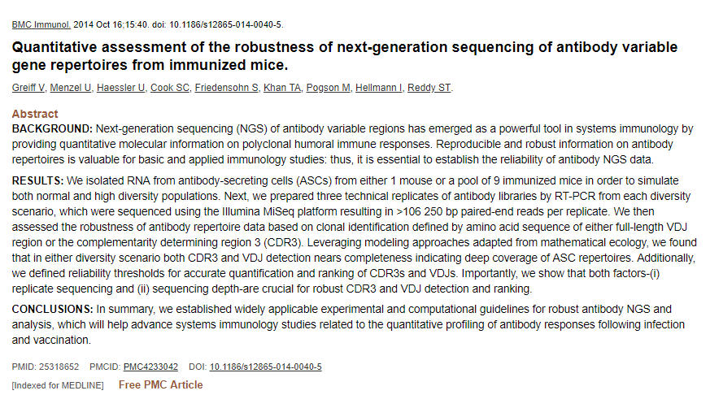
Pre-processing example using AIRR community data (reference manuscript)

Slide 6
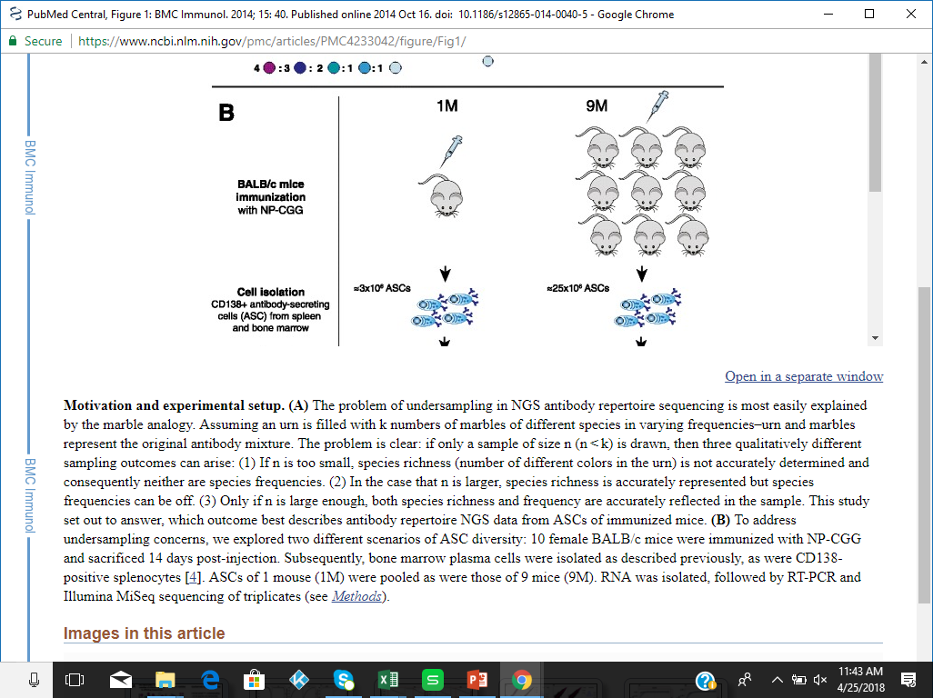
Experimental Setup (reference manuscript)

Slide 7
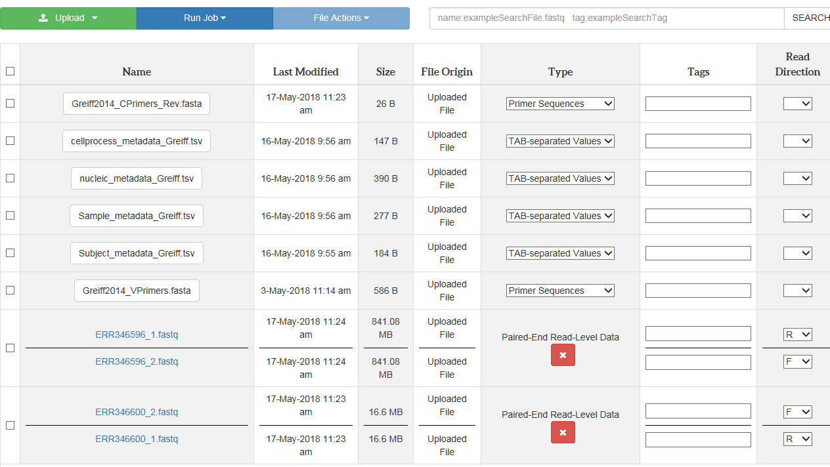
A look at the vdjpipe application (exploring pre-processing steps on VDJServer)

Slide 8
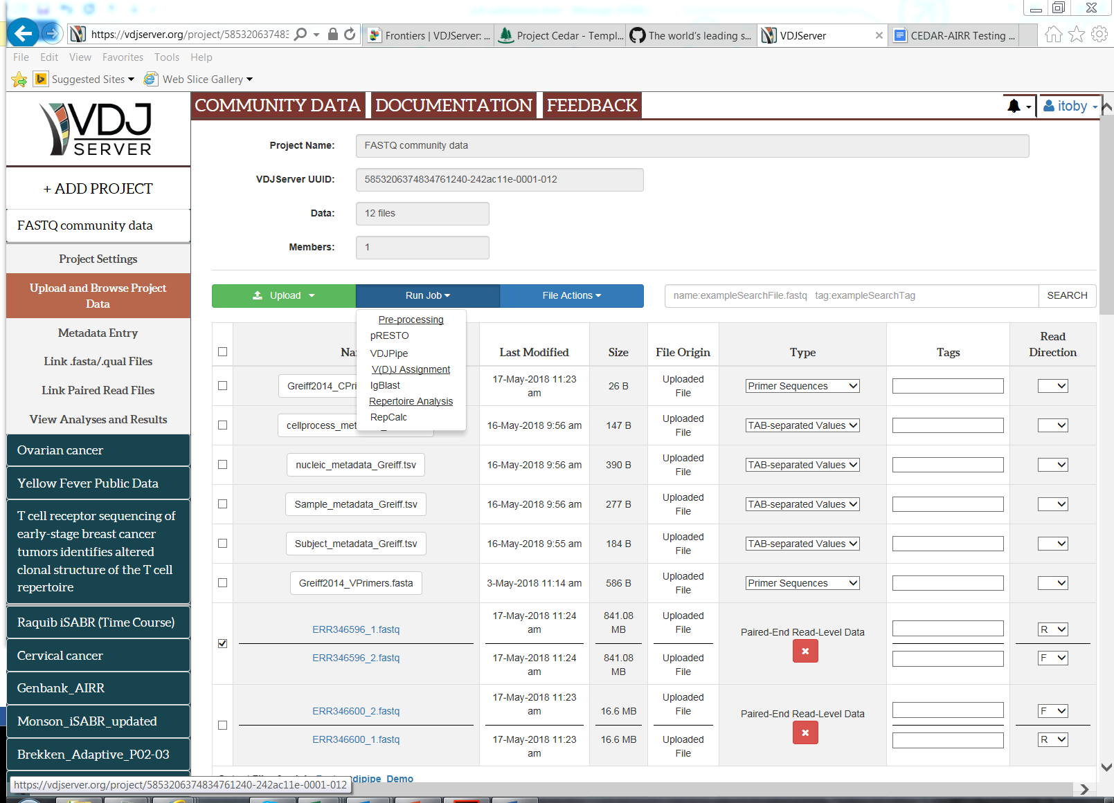

Slide 9
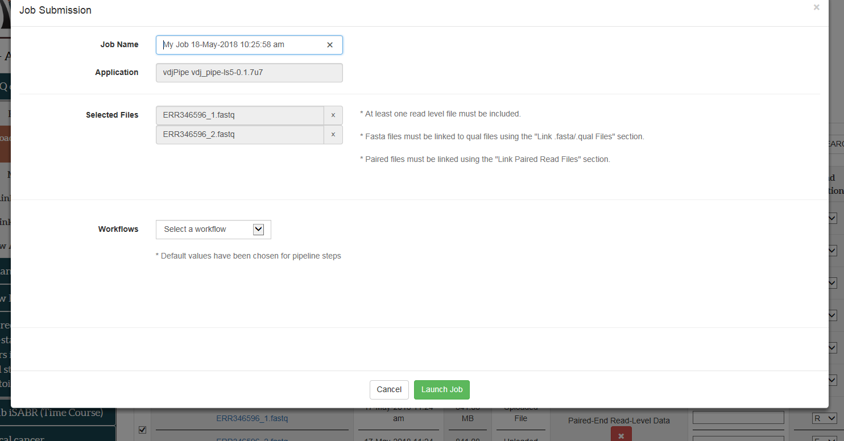

Slide 10
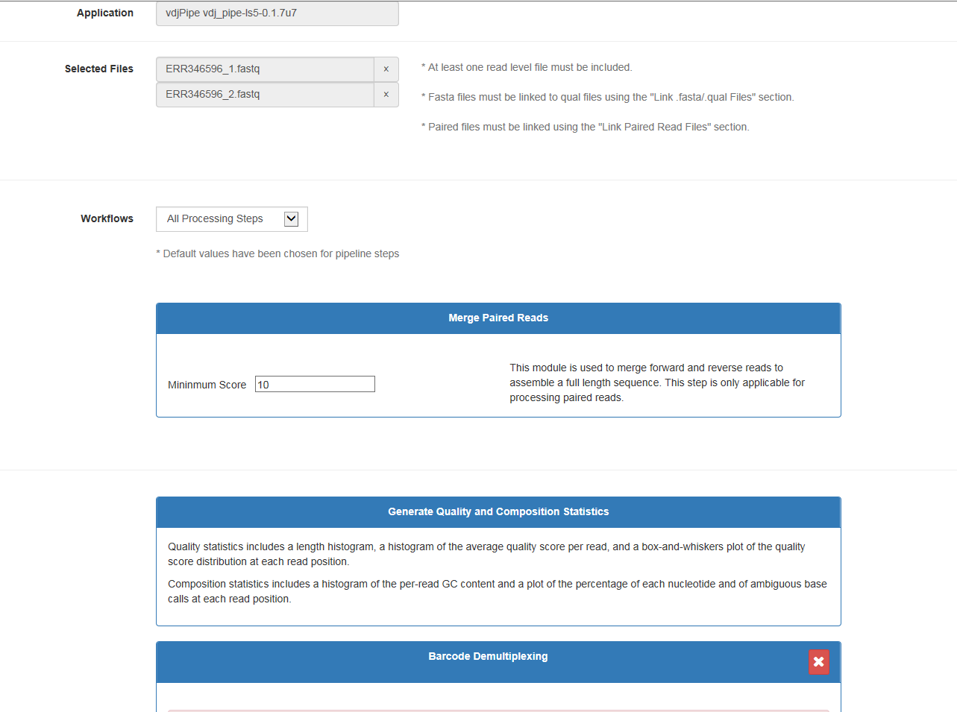

Slide 11
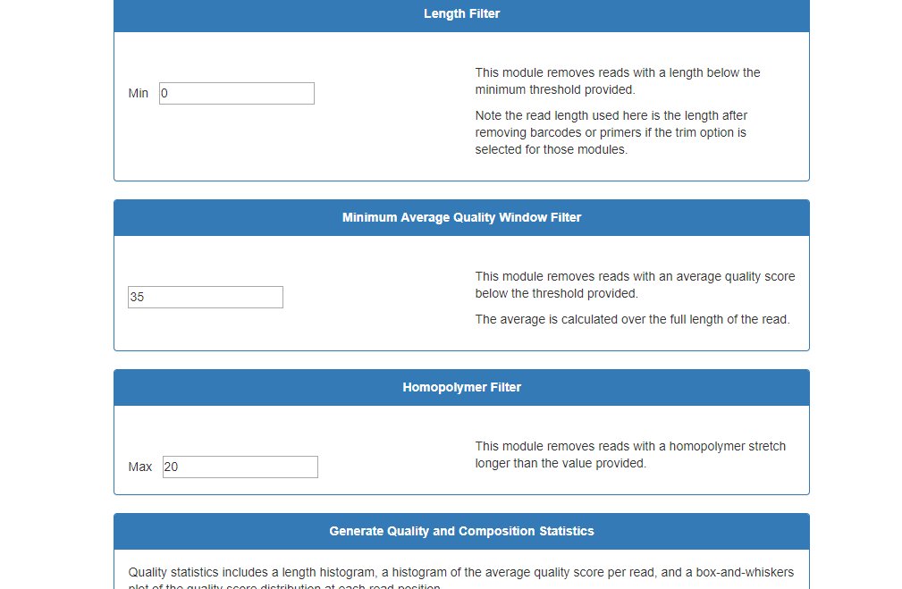

Slide 12
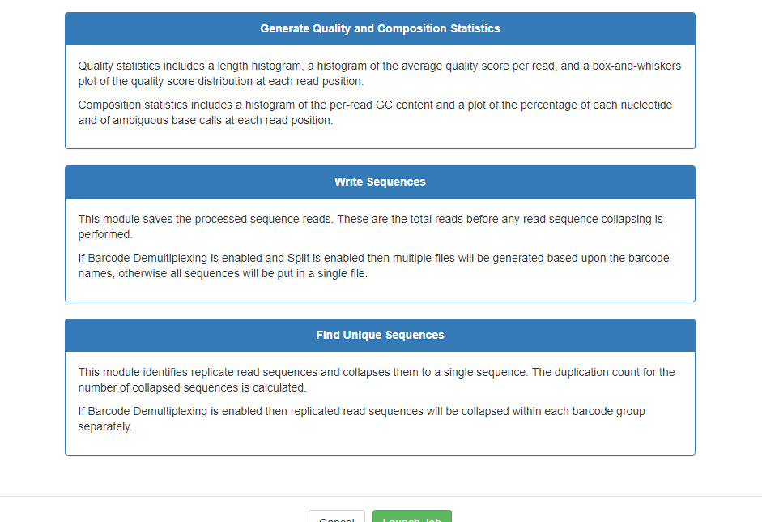

Slide 13
Pre-processing with Fastq files (review)

Slide 14
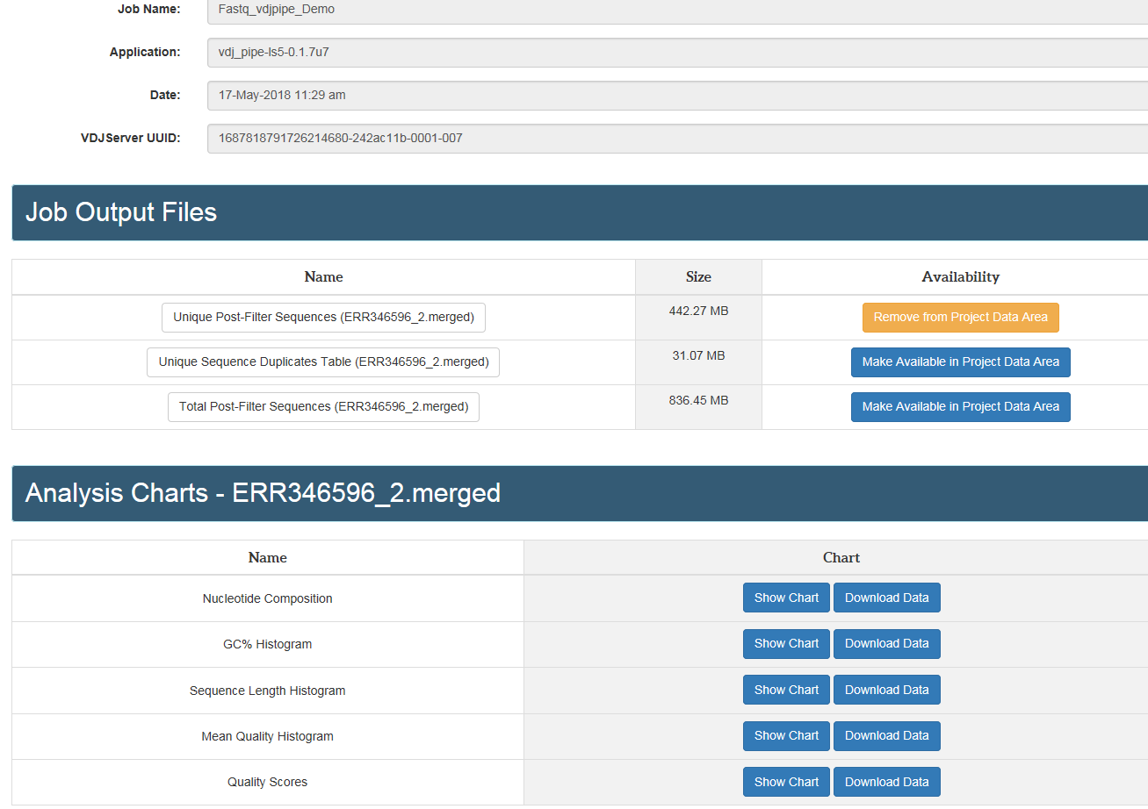
Output files from pre-processing steps

Slide 15
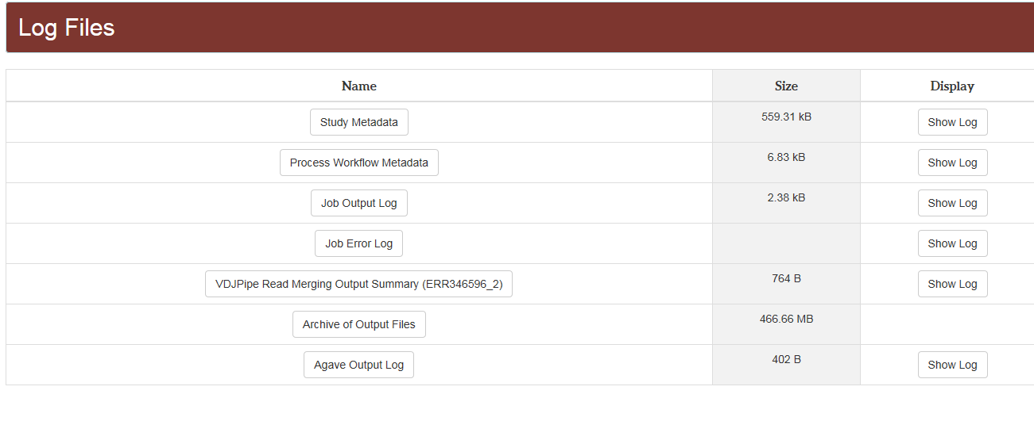
Output files from pre-processing steps

Slide 16
Pre-processing summary
Files uploaded to VDJServer
Selection of processing steps for vdjPipe application
Run files and generate processed fasta files
Proceed with vdj assignment using the IgBlast application and followed by repertoire calculations (using repcalc)

Slide 17
AIRR Community and MiAIRR Standards
Reference handouts

Slide 18
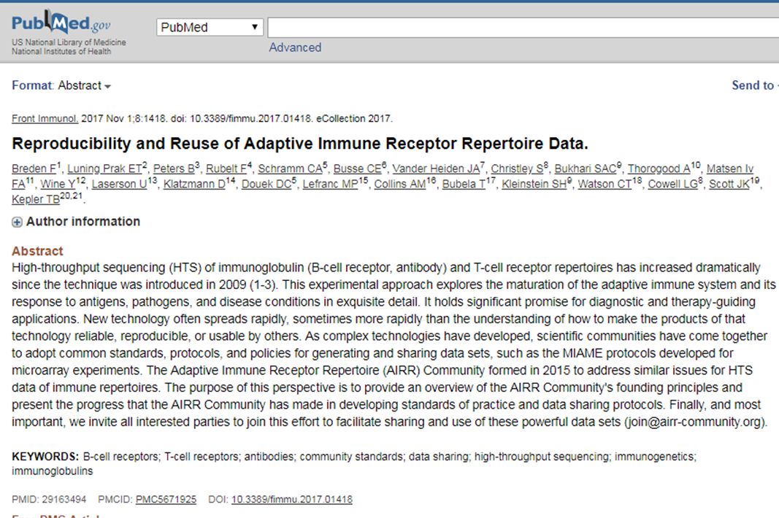

Slide 19
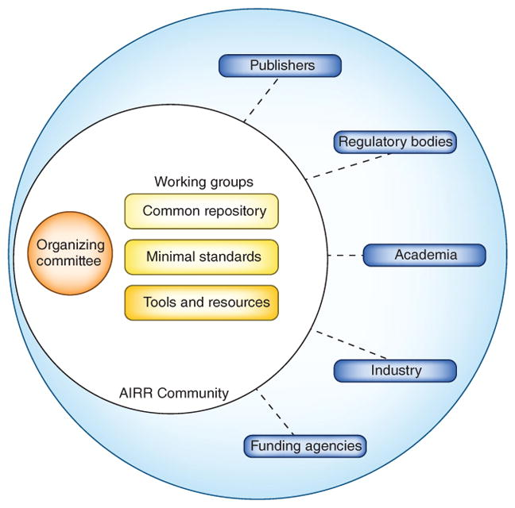
AIRR community interactions

Slide 20
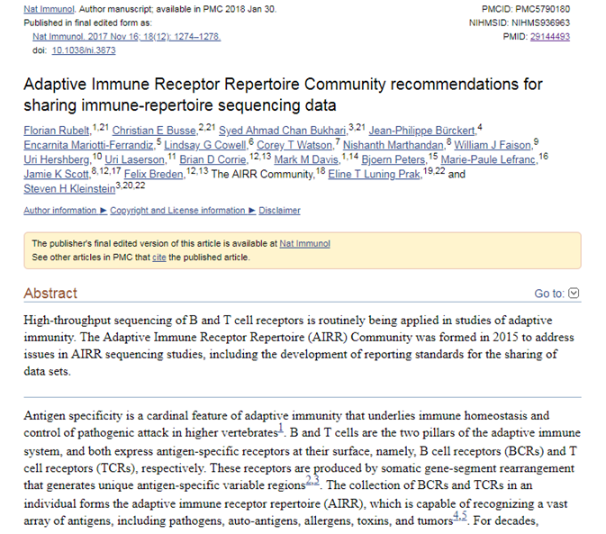

Slide 21
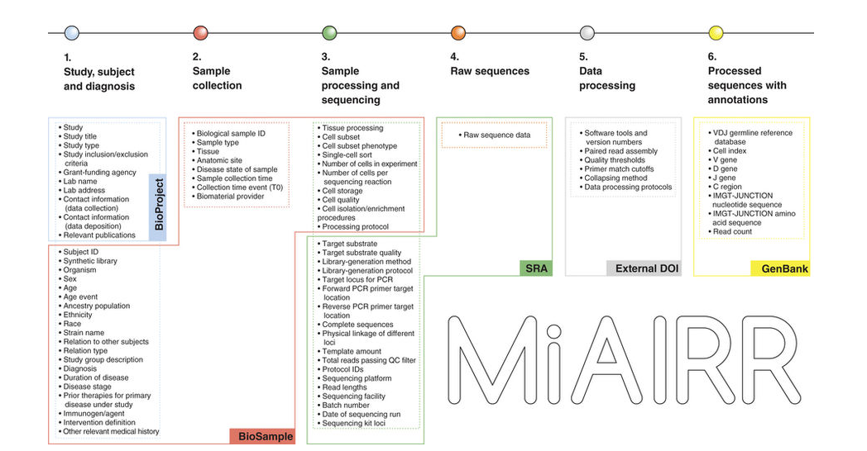

Slide 22
Summary
The Adaptive Immune Receptor Repertoire (AIRR) Community formed in 2015 to address reproducibility and reuse issues for HTS data of immune repertoires.
The community has made significant progress in developing standards of practice and data sharing protocols.
The key recommendations set forth comprise of six MiAIRR sets and associated data fields, along with their target submission repositories to promote data standardization across all the studies within the community.
VDJServer enables you to fulfill all of the MiAIRR submission requirements covered by the six sets and also provides you with a “one-stop” shop from start to finish.

Slide 23
Repertoire Calculations Overview

Slide 24
Typical data analysis questions (some examples)
What are the cdr3 sequence patterns across samples?
What are gene segment usage patterns across samples?
Which cdr3 sequences are shared across samples?
What is the diversity observed across samples?
These analysis questions can be targeted at:
subject
sample
sample group (using available metadata)

Slide 25
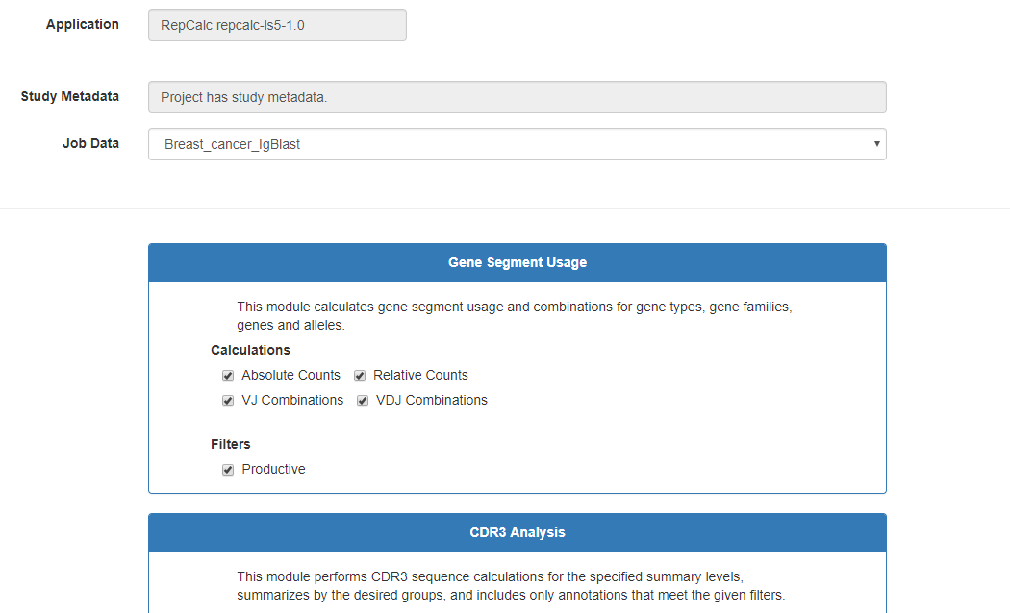
Exploring repertoire calculation options on VDJServer

Slide 26
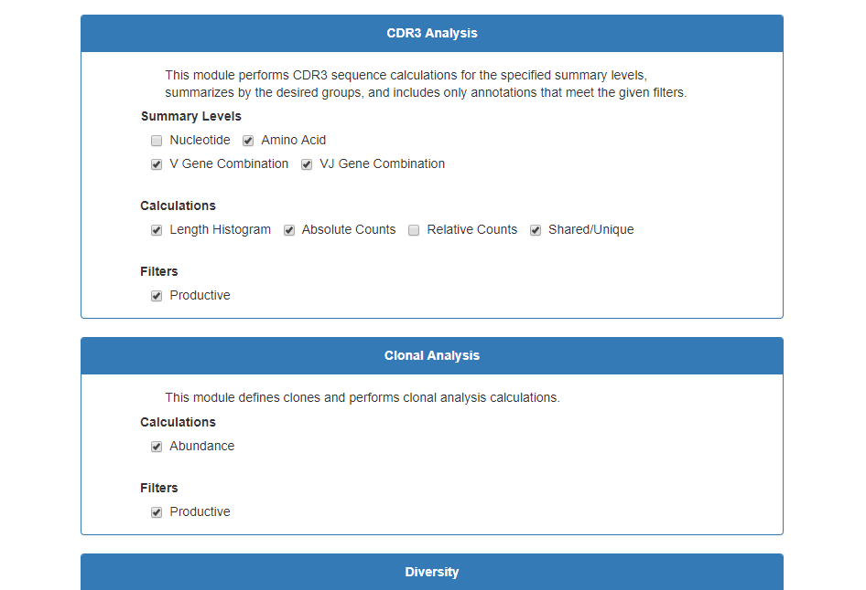

Slide 27
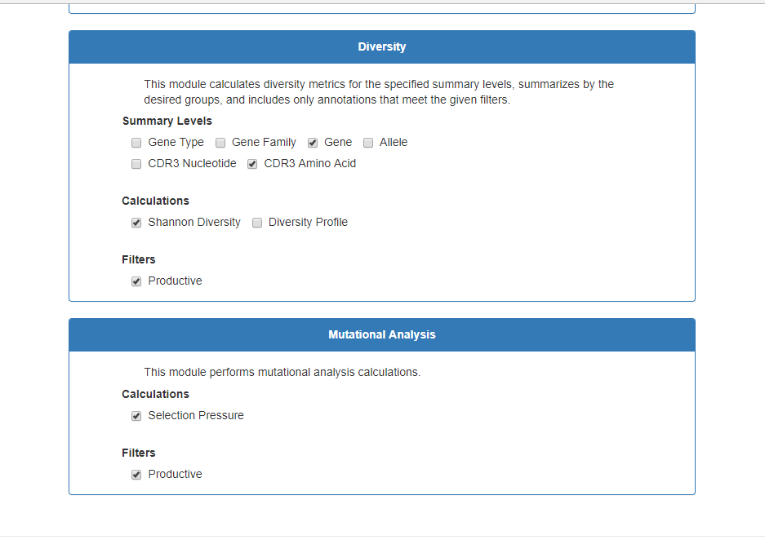

Slide 28
Summary
VDJServer offers interactive visualizations for users
VDJServer executes all steps and generates analysis reports complete with data summary tables, statistical analyses, figures and workflow logs
VDJServer improves the efficiency of analysis by eliminating eh need for significant manual manipulation of data
This improves data accuracy and reliability
VDJServer makes sophisticated computational calculations easily accessible

